Slide 1
Consumer Behavior 15.847
Class 2
Two ways of thinking

Slide 2
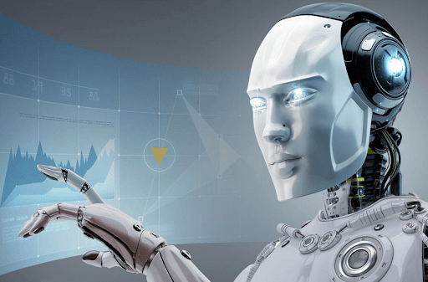
People act rationally to maximize money

Slide 3
People act rationally to maximize money

Slide 4
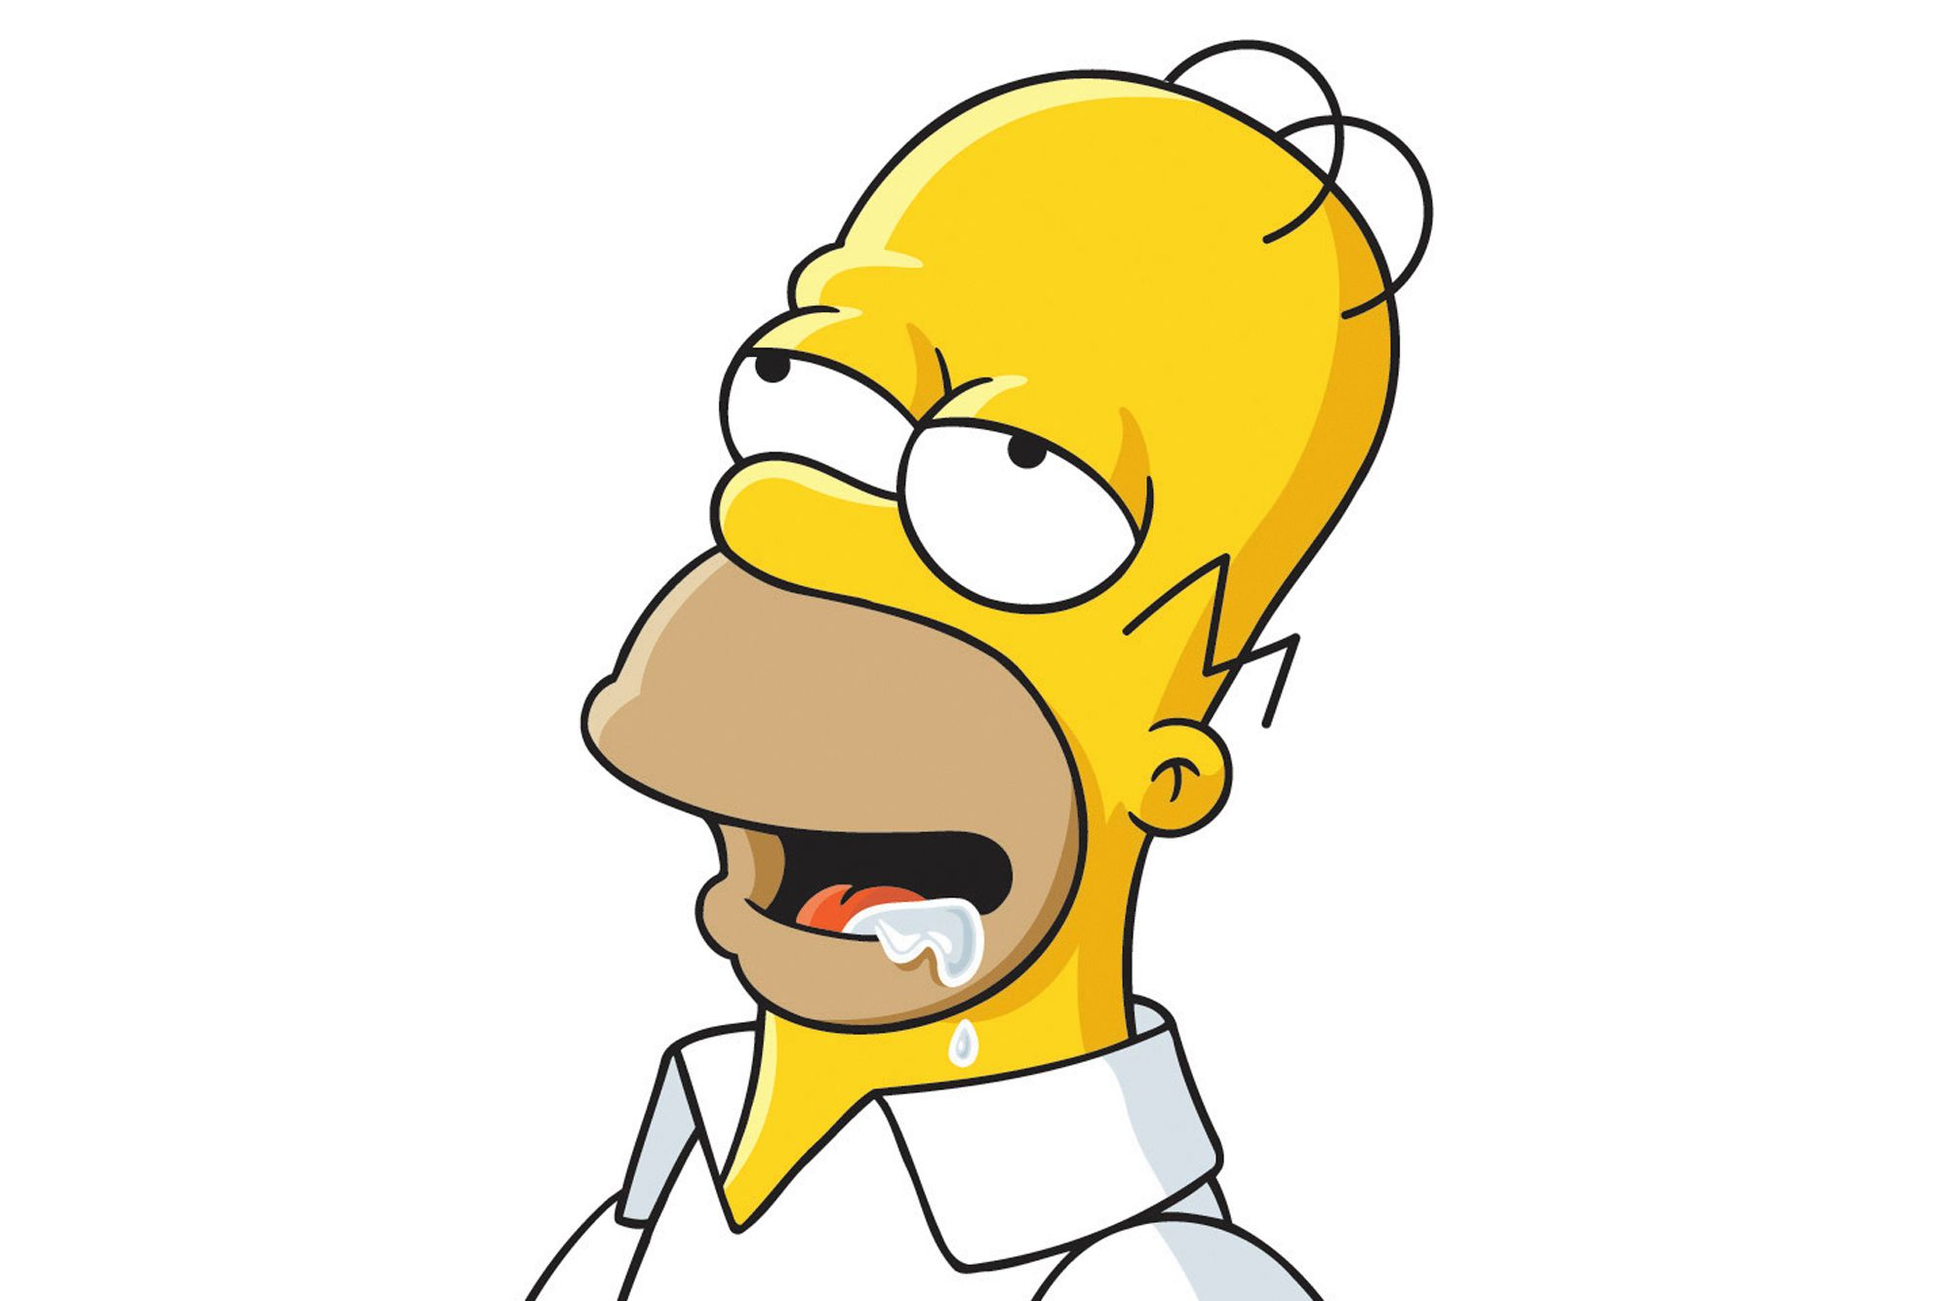
People act irrationally?

Slide 5
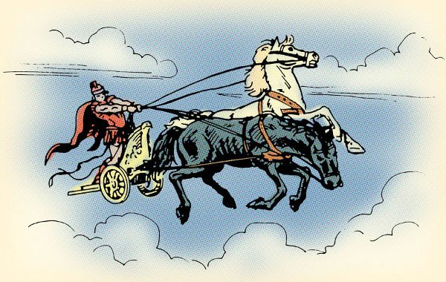
Plato’s Chariot Allegory

Slide 6
Stroop Task
What color is the text?
Dog
Cat
Monkey
Elephant
Ship
House
Plane
Red
Blue
Yellow
Orange
Brown
Pink
Green
Notes:
Try it again. Notice you haven’t gotten any better. Which design is thus not possible?

Slide 7
Quiz! Answer as quickly as you can S1: shorturl.at/krvAO S2: shorturl.at/aftPZ

Slide 8
Cognitive Reflection Test (CRT)
Developed by Shane Frederick (Yale SOM)
Predictive of decision-making across a wide range of settings
→ Above and beyond demographics like age, gender, education

Slide 9
Cognitive Reflection Test
A bat and a ball cost $1.10 in total. The bat costs $1.00 more than the ball. How many cents does the ball cost?
If it takes 5 machines 5 minutes to make 5 widgets, how many minutes would it take 100 machines to make 100 widgets?
In a lake, there is a patch of lily pads. Every day, the patch doubles in size. If it takes 48 days for the patch to cover the entire lake, how many days would it take for the patch to cover half of the lake?
Emily's father has three daughters. The first two are named April and May. What is the third daughter's name?
When you are running a race and you pass the person in second place, what place are you in?
A farmer had 15 sheep and all but 8 died. How many are left?
Frederick 2005

Slide 10
Impatience
Would you prefer $3400 this month or $3800 next month?
Low CRT score: 35% delayed gratification
High CRT score: 60% delayed gratification
Willingness to pay for overnight shipping of chosen book (circa 2005)
Low CRT score: $4.54
High CRT score: $2.18
Frederick 2005

Slide 11
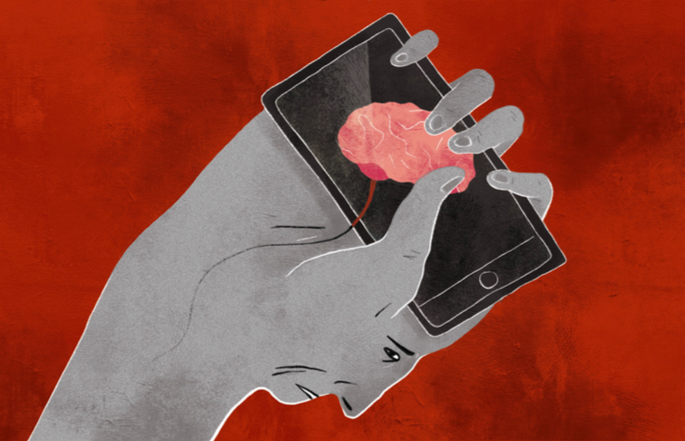
Offloading your thinking
Barr et al 2015

Slide 12
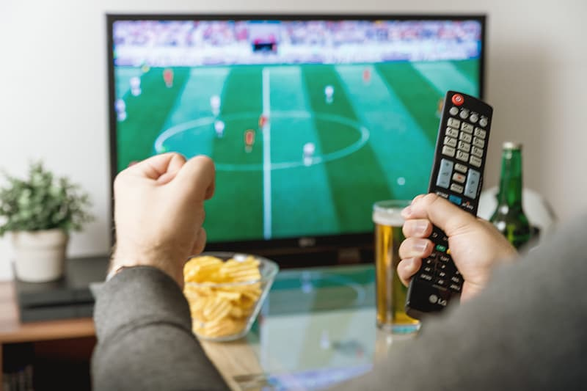
Interests
Do you watch professional sports?
CRT Score
CRT Score

Slide 13
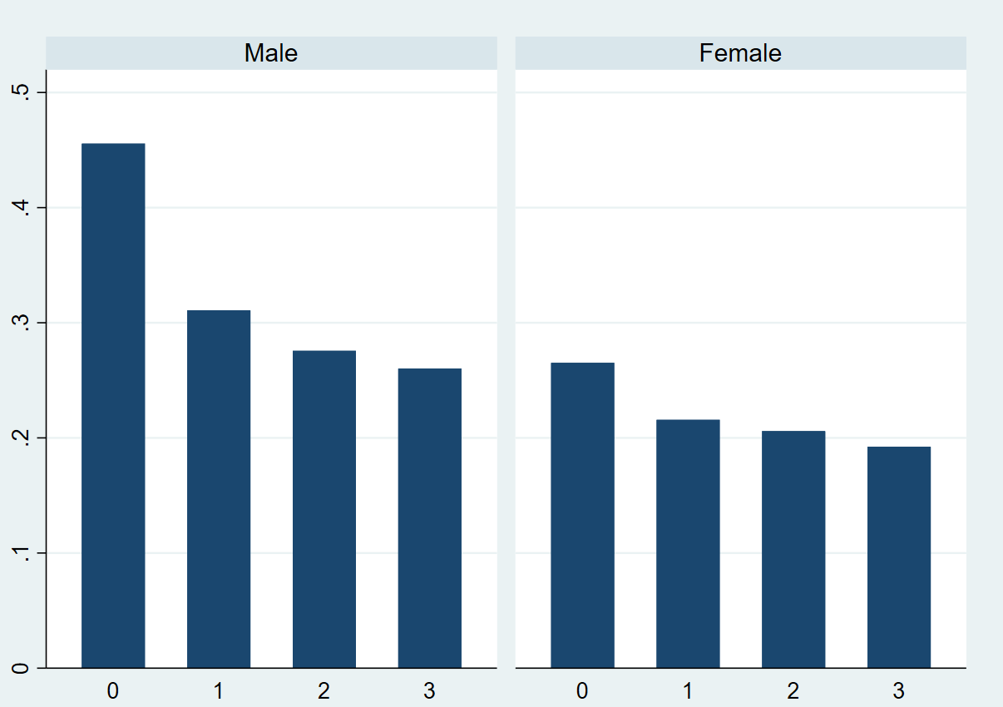
Emotion Regulation
How upset do you get when your favorite team loses?
CRT Score
CRT Score

Slide 14
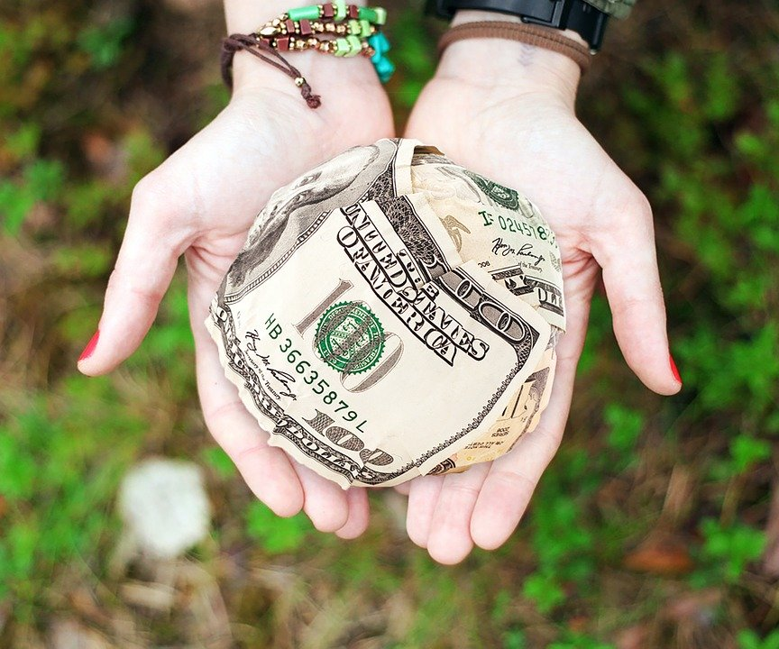
Altruism
CRT Score
Arechar et al 2017

Slide 15
Bullshit detection
“Transcendence transforms the doorway to excellence.”
Pennycook et al 2015

Slide 16
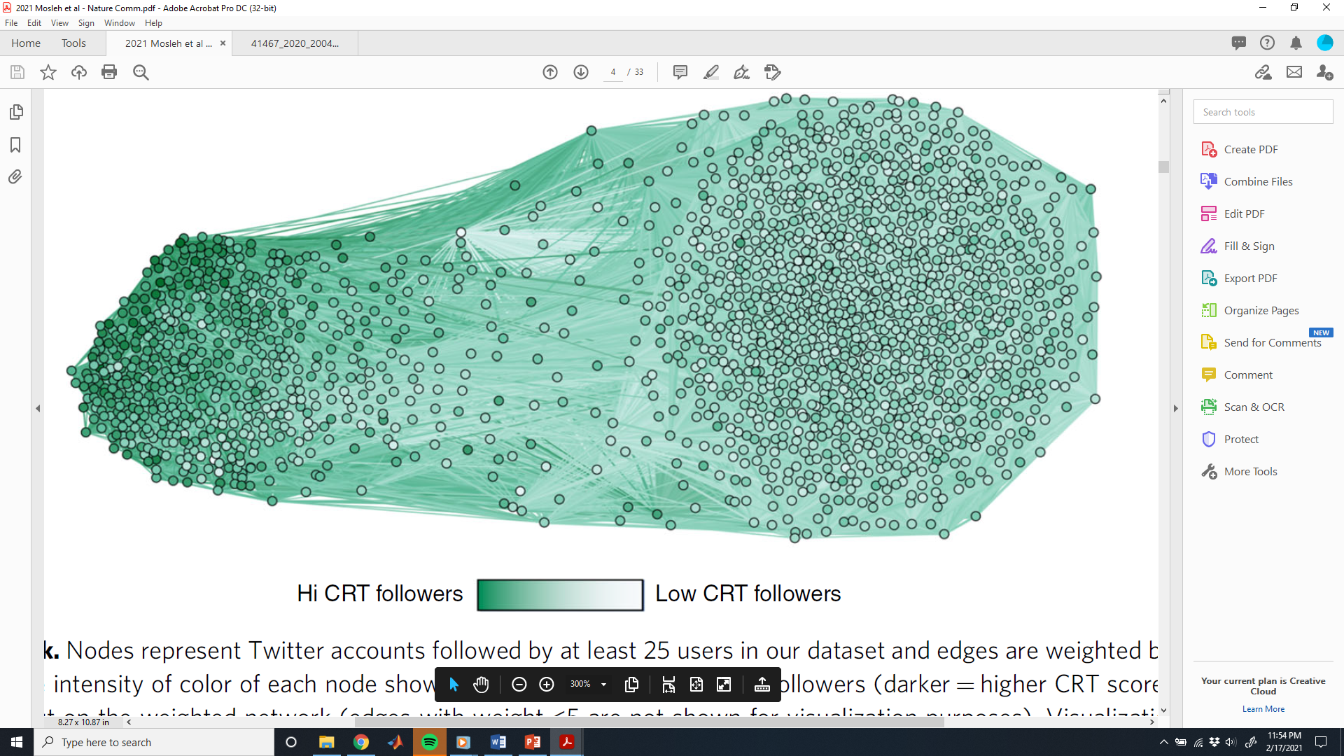
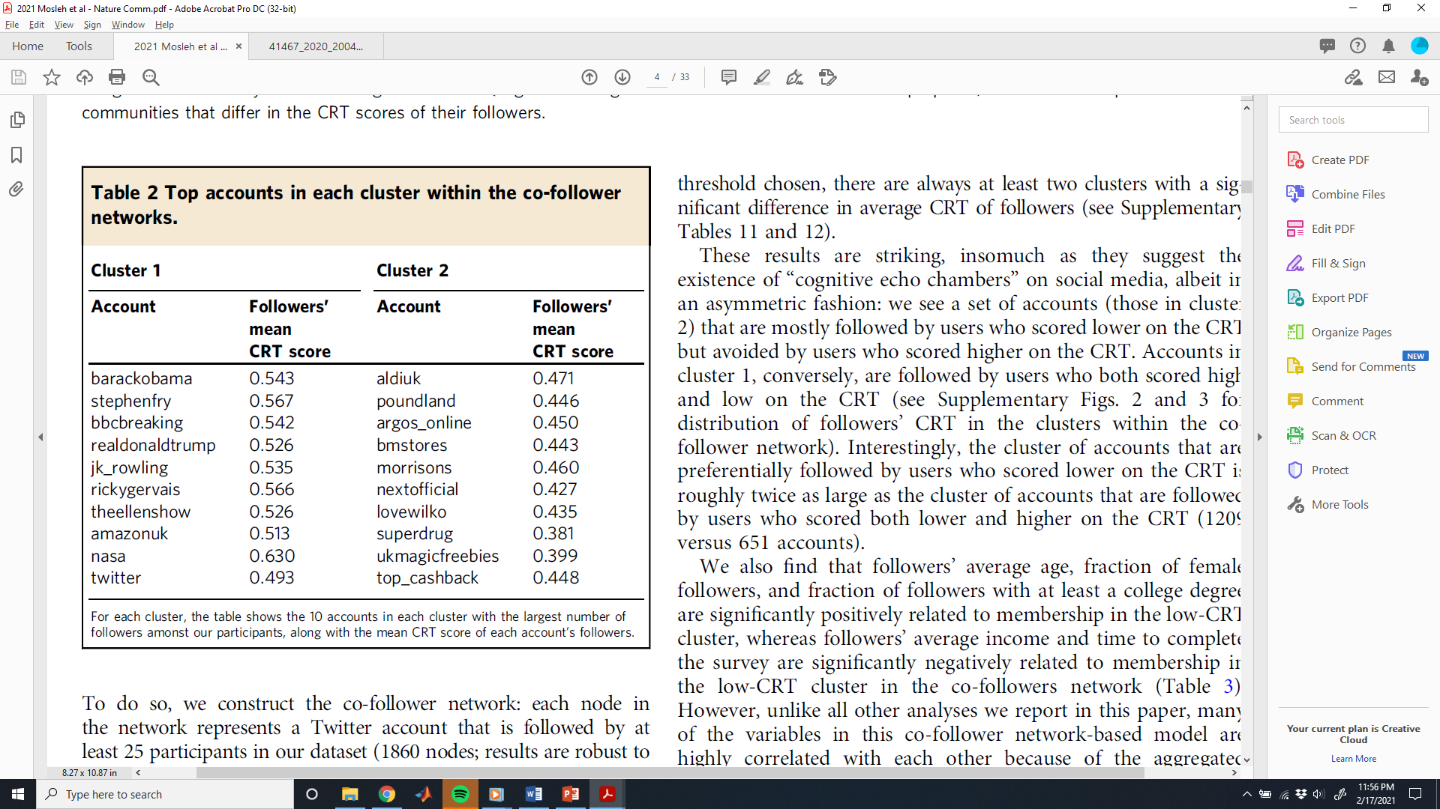
Social media behavior
1860 Twitter accounts with >25 followers among our subjects
Edges weighted by # shared followers
Darker color – higher average CRT of followers
Mosleh et al 2021

Slide 17
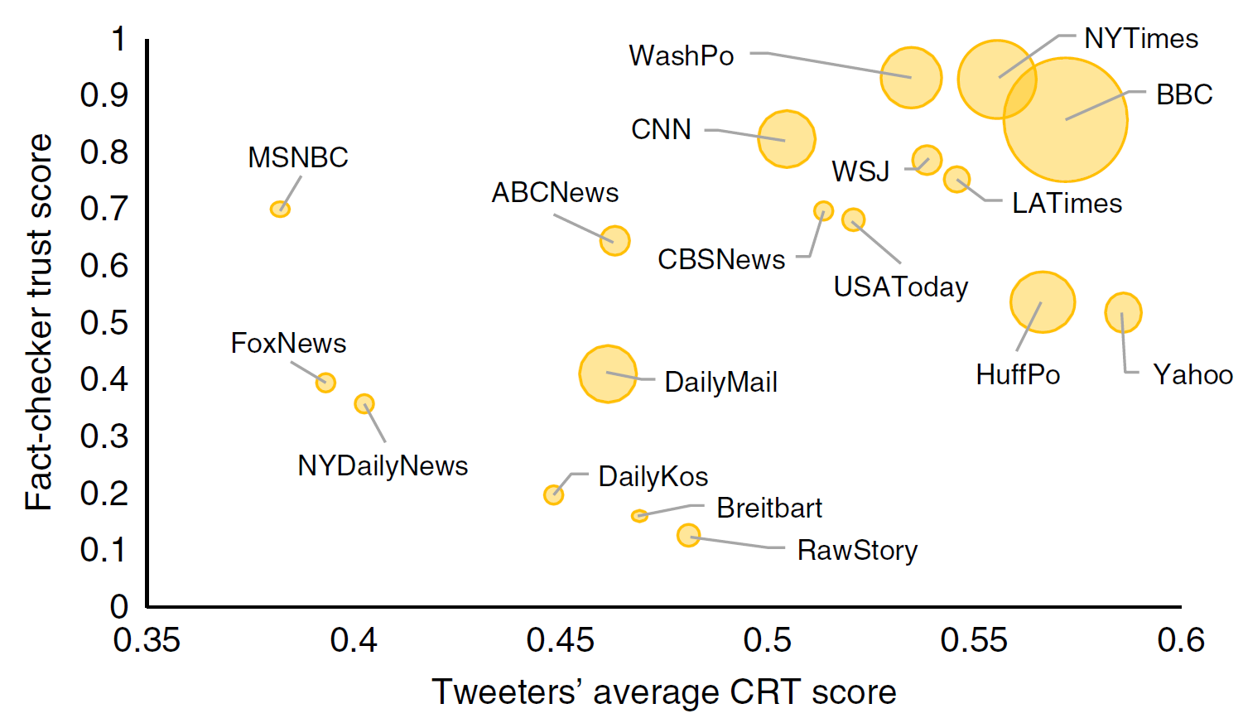
News consumption
Mosleh et al 2021

Slide 18
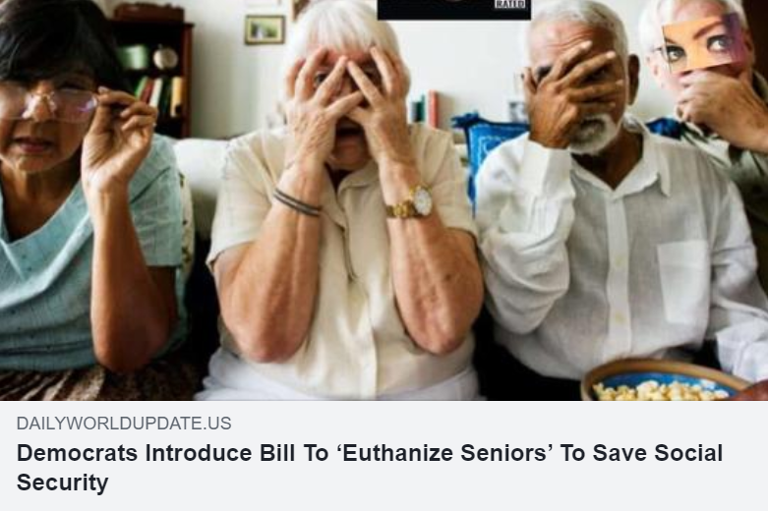
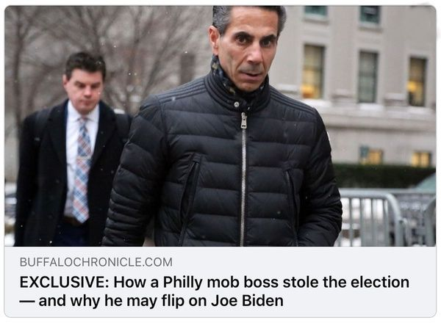
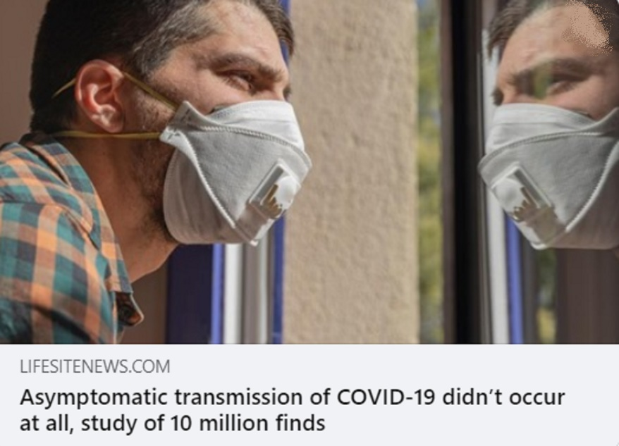
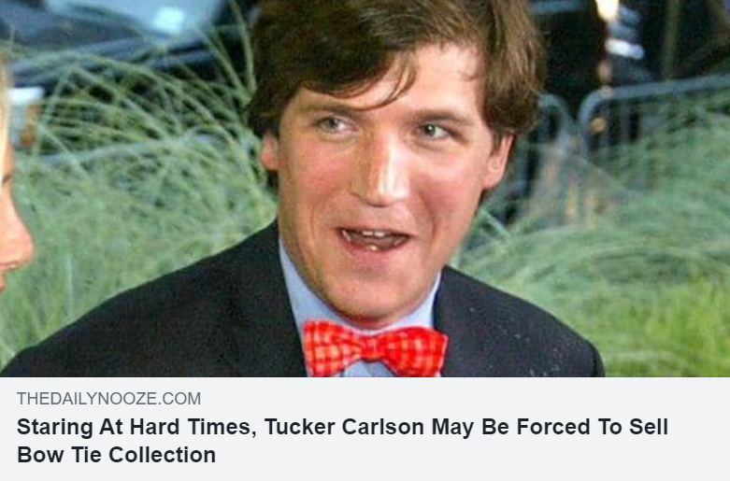
Detecting Fake News

Slide 19
Detecting Fake News
Pennycook et al 2021

Slide 20
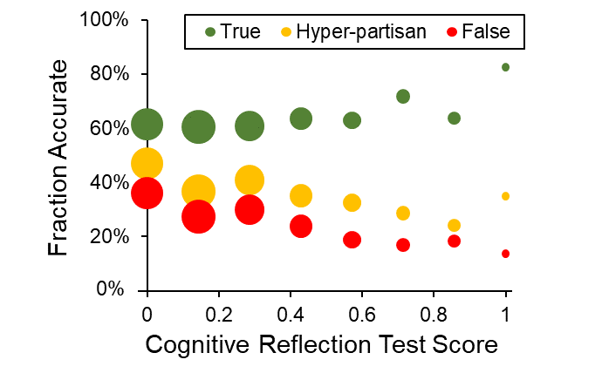
Detecting Fake News
Fraction rated “Accurate + Unbiased”
Ross et al 2021

Slide 21
Dual-process models of decision-making

Slide 22
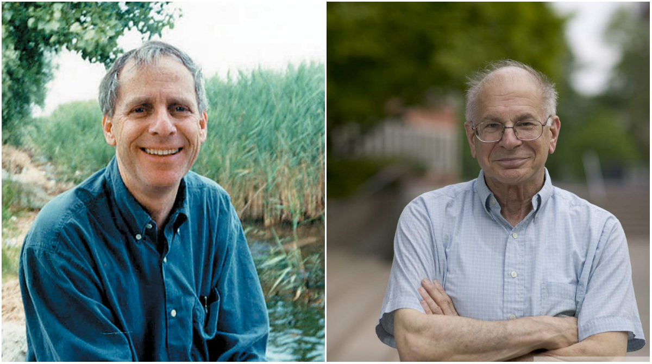
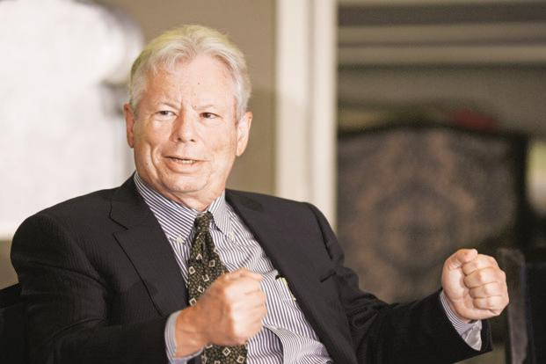
Amos Tversky Daniel Kahneman
Dick Thaler

Slide 23
Two “Systems”
INTUITION
SYSTEM 1
REASONING
SYSTEM 2
Associative
Fast
Parallel
Effortless
Slow-learning
Emotional
Automatic
Rule-governed
Slow
Serial
Effortful
Flexible
Neutral
Controlled
Kahneman 2003
Kahneman, 2003
Notes:
Two cognitive systems are employed when people make judgments and decisions.
Whereas the organizing principle of system 2 is logical coherence – thoughts must follow from each other and not be contradictory
Organizational principle of system 1 is coherence of associations

Slide 24

Two “Systems”
One way thoughts come to mind
17 X 26 =
Notes:
442; “Whoa, he’s angry!”

Slide 25
Two “Systems”
The product 17 x 24
A sequential computation, governed by a rule

Slide 26
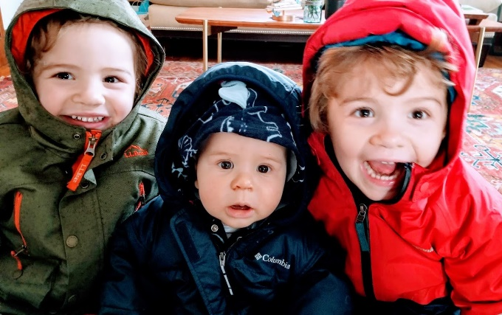
Two “Systems”
One way thoughts come to mind
Another way thoughts come to mind
17 X 26 =
Notes:
442; “Whoa, he’s angry!”

Slide 27
Two “Systems”
The product 17 x 24
A sequential computation, governed by a rule
The impression that my son is happy
– Simply comes to mind (within 200 msec.)
– He looks happy, just as he is wearing a jacket.
The subjective experience of intuitive thinking resembles perception
– It feels like something that happens to us; not something we do

Slide 28
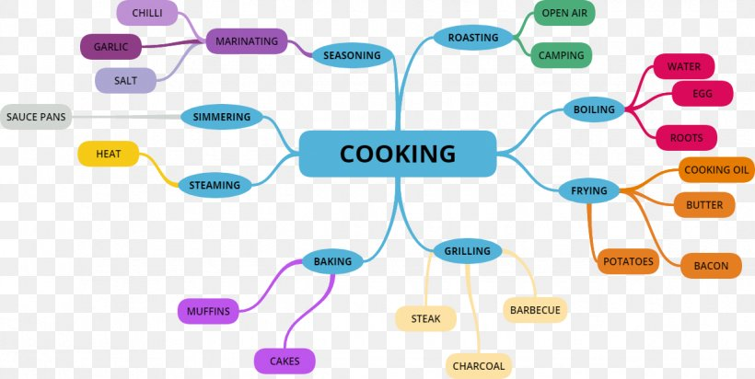
System 1: Associative

Slide 29
System 1: Associative
SNAKE

Slide 30
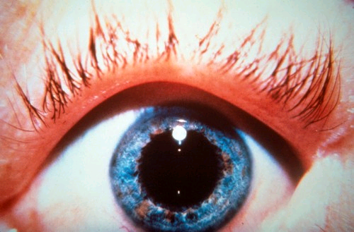
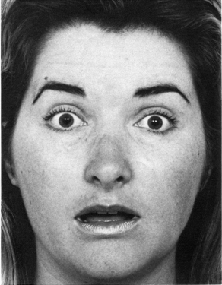
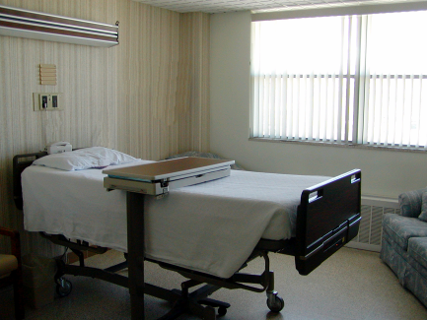
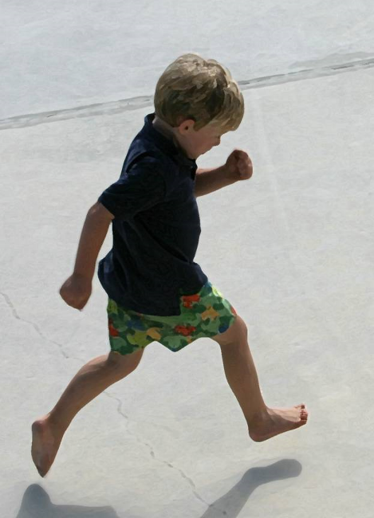

DANGER
BITE
POISON
TEETH
FEAR
Notes:
Quite a lot happened in you during the last second or two, while you were staring at this word – which of course you could not help doing. Your mind was flooded by images and memories, most unpleasant. Your body also reacted. There was a physiological response (including a dilation of the pupil, which in this case does not indicate effort but only emotional arousal). A lie-detection device would have detected that the hair on your arms stood on end and that your sweat glands were activated. Your face twisted in a slight expression of fear. You recoiled slightly. You became more alert and vigilant than usual. Tests of your ability to recognize whispered words would reveal that you are currently very sensitive to a large set of words: danger, poison, bite… The level of organization present in the response your body produced to this word illustrates the basic mechanism of the automatic pilot of the mind: the spreading of activation in a network of ideas.

Slide 31
Scoring the two Systems
Which is better?
Why?

Slide 32
Scoring the two Systems
Intuition: Stupid?
On the contrary, many complex behaviors become intuitive as high skill is achieved
Reason: Always smart and right?
No. Computations and careful thoughts can be wrong, both factually and logically. Also, more effortful.
Which System controls judgments and actions?
Normally, behavior is skilled and effortless (intuition), but reason monitors and can try to take over

Slide 33
Trait versus State
CRT score = How much you generally tend to deliberate
Moment to moment variation
Tired, hungry, distracted, emotional → Less deliberation
High stakes → More deliberation

Slide 34
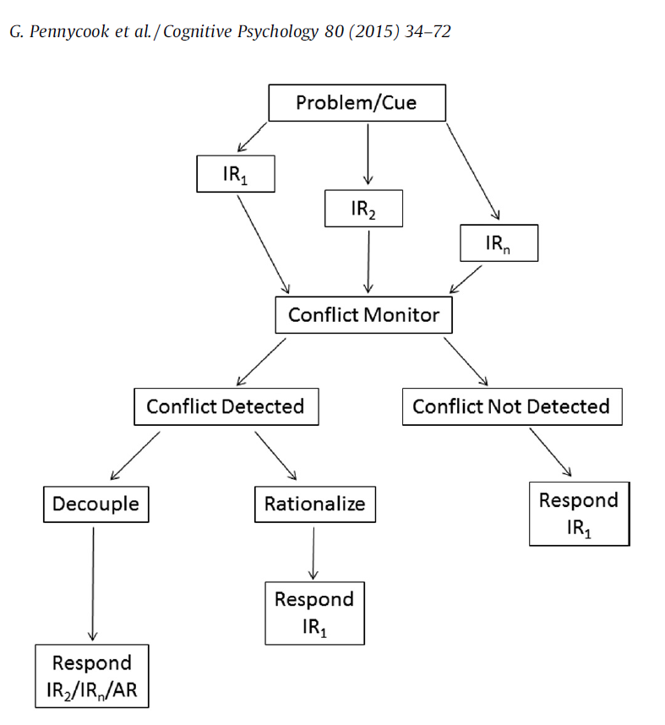
What makes you think?

Slide 35
Heuristics
Methods that use principles of effort reduction and simplification
Allow decision-makers to process information and reach decisions in a less effortful manner than optimal decision rules
Rules of thumb = typically work, but sometimes lead you astray

Slide 36
Biases
Because heuristics often do not adhere to normative rules (e.g., logic, probability), they produce errors that are both systematic and predictable
Conceptual Framework: Intuition = typically successful response
→ Note that this means that intuitive/heuristic responses are often right – it’s just in atypical situations that they lead you astray
Learning about biases helps reason adjust
Notes:
Note that this kind of bias is not akin to a simple response bias

Slide 37
More sensitivity to decision details comes with a cost (time, cognitive effort)
Ease
Flexibility

Slide 38
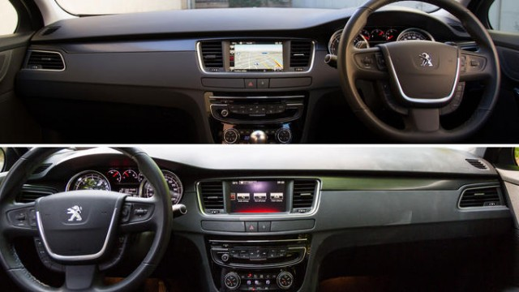
Ease (I) vs. Flexibility (R)

Slide 39

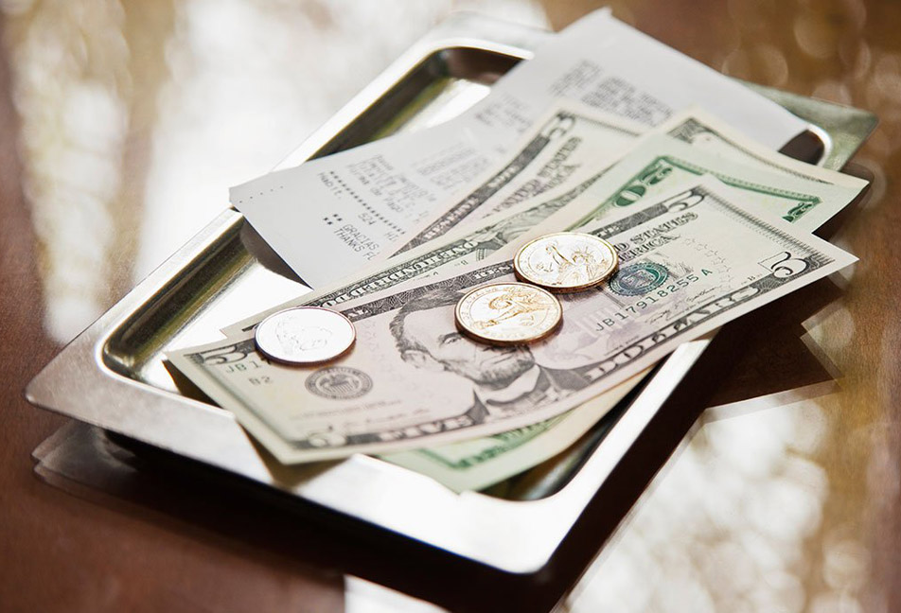
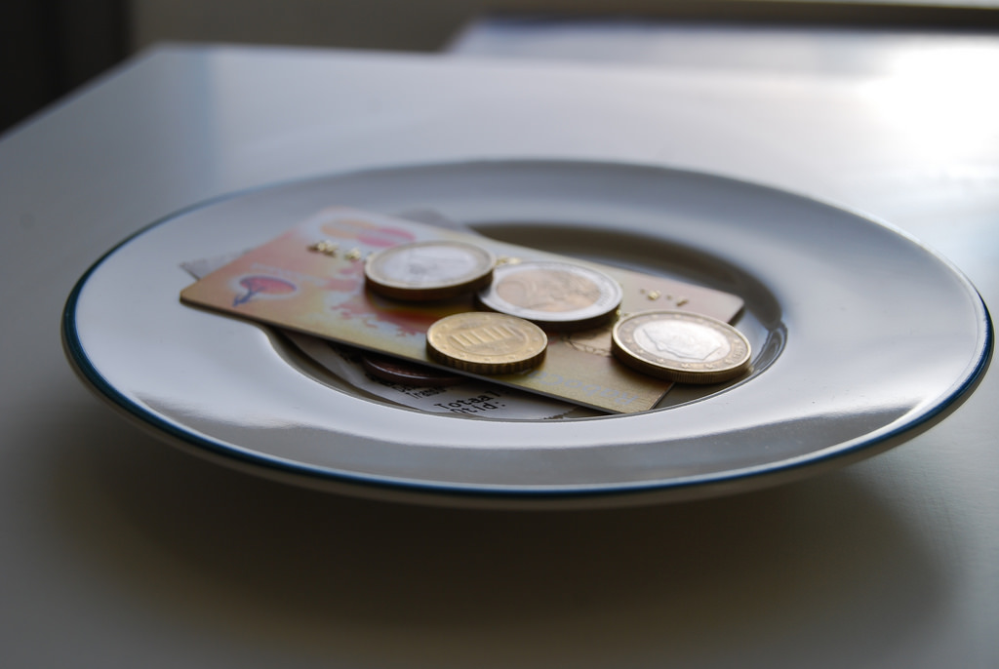
Ease (I) vs. Flexibility (R)

